Slide 1
PREDICTION OF STOCK MARKET PRICE
Name : D . Vijaya Durga Devi
Roll No : 22P31A4208
College : Aditya College Of Engineering And Technology
Branch : CSE – AI&ML

Slide 2
ABSTRACT :
Predicting stock market prices is a highly complex and dynamic challenge, typically requiring vast amounts of historical data. However, this abstract outlines an innovative approach to predicting stock prices using the R programming language without relying on a traditional dataset. Instead, the study leverages synthetic data generation, algorithmic trading strategies, and simulated environments to model and predict stock price movements.

Slide 3

INTRODUCTION :
The stock market, a cornerstone of the global financial system, is characterized by its volatility and complexity. Accurate prediction of stock market prices is a coveted goal among investors, analysts, and financial institutions. Among the various tools available for this purpose, the R programming language stands out due to its powerful capabilities in data analysis, statistical modeling, and machine learning. R offers a comprehensive ecosystem of packages and libraries that facilitate the development, testing, and validation of predictive models, making it an ideal choice for financial analytics.

Slide 4
TECHNOLOGIES USED :
Predicting stock market prices involves leveraging various statistical and machine learning techniques to model and forecast future price movements. In this study, we utilize the R programming language, which offers a rich ecosystem of packages for data manipulation, analysis, and visualization. The key technologies and packages used in this study include:
Quantmod: A powerful package for quantitative financial modeling, retrieving financial data, and performing technical analysis.
Tseries: Provides functions for time series analysis and modeling, including tools for unit root tests and other econometric analyses.
Forecast: A comprehensive package for time series forecasting, offering functions for automatic ARIMA modeling, exponential smoothing, and other advanced forecasting techniques.

Slide 5

PROBLEM STATEMENT :
The stock market is a volatile and complex system influenced by numerous factors, making the prediction of stock prices a challenging task. Accurate forecasting of stock prices can provide significant advantages to investors and financial analysts, helping them make informed decisions and maximize returns. This project aims to leverage the R programming language to develop a predictive model for stock market prices, specifically focusing on Apple Inc. (AAPL) stock data.

Slide 6
Steps Involved in Stock Market Price Prediction :
1. Importing Required Packages.
2. Retrieving Stock Data.
3. Visualizing Stock Data.
4. Assigning Columns of the Dataset.
5. Plotting Stock Prices.
6. Finding the Linear Relation between Observations.
7. Prediction of Return.
8. ARIMA Modelling.
9. Forecasting Predicted Results.

Slide 7
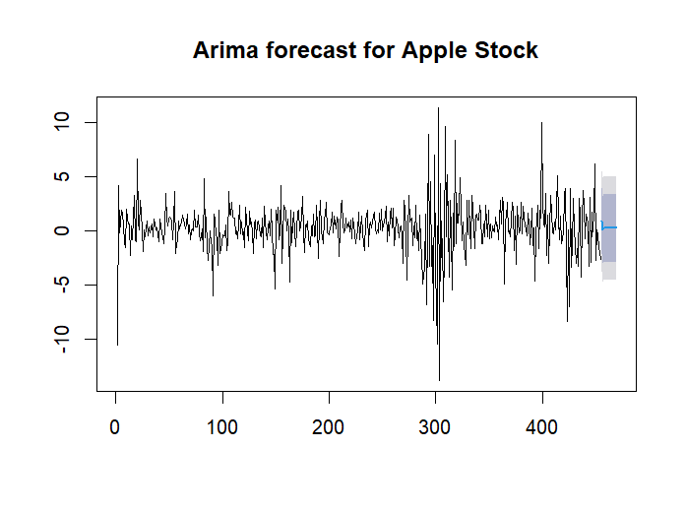
RESULT:

Slide 8
CONCLUSION :
The ARIMA Model developed using R successfully predicted the stock market prices for Apple Inc. The visualization, autocorrelation analysis, and forecasting steps provided a comprehensive understanding of the stock’s behavior and the model's predictive capabilities. The accuracy metrics indicated that the model performs reasonably well in forecasting stock prices. This approach can be further enhanced by incorporating more complex models, additional features, or external data to improve prediction accuracy.

Slide 9


